Slide 1

Is Air Travel the safest modest of transportation?
Supraja Rapuru

Slide 2
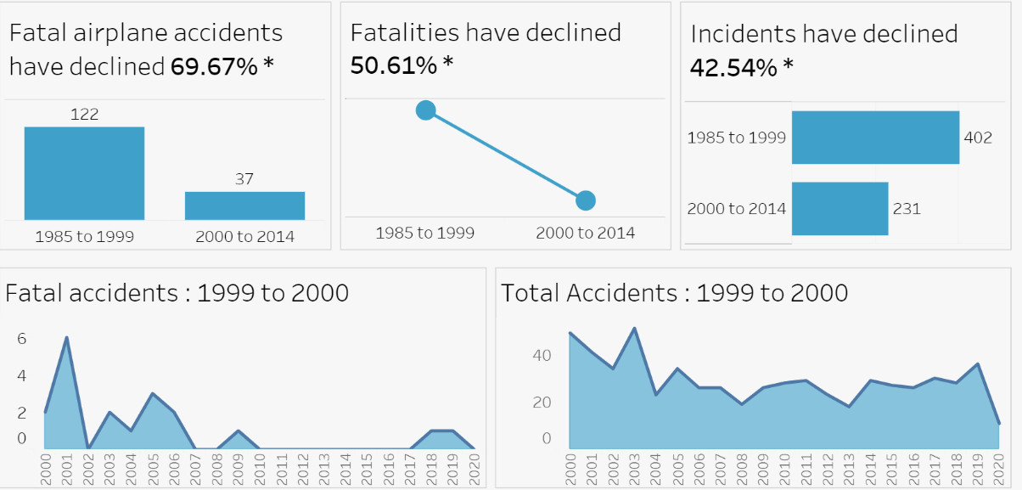
Air travel Statistics

Slide 3
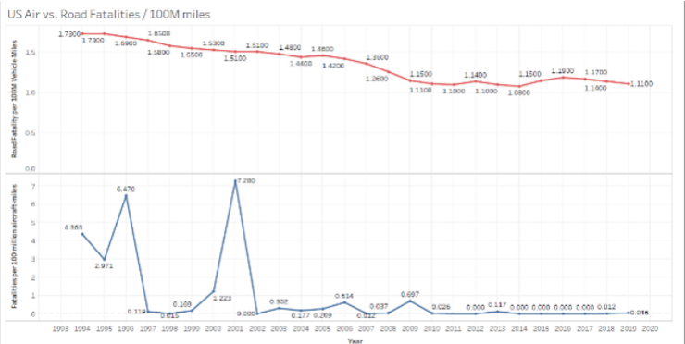
Air vs Ground Fatalities in Last 30 Years
in 2020 we have approx. 1.11 ground fatality VS 0.04 Air fatality per 100 Million travel miles.

Slide 4
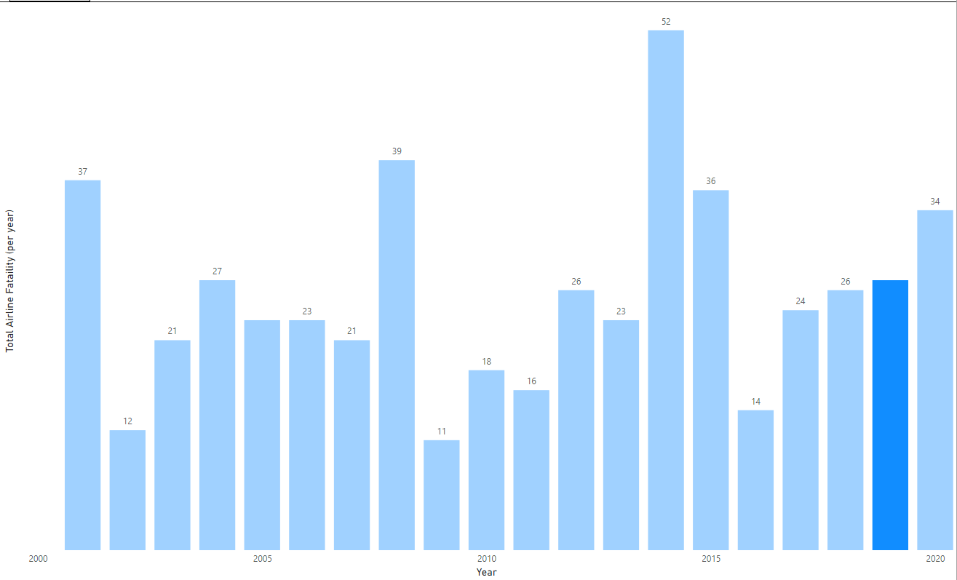
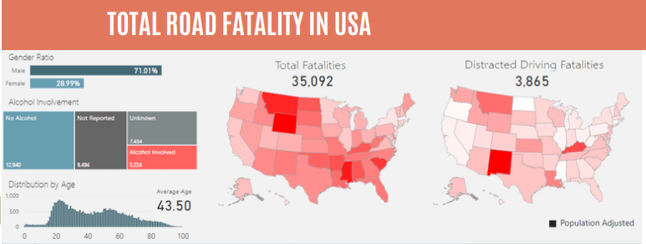
Air vs Ground Fatalities in Last 30 Years
Total Air Fatality in 2019 is 24
Vs
Total Road Fatality in the USA is 35092.

Slide 5
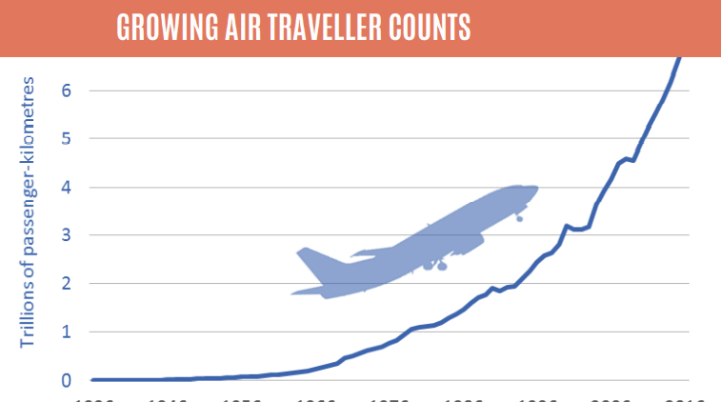
Growing Air travel Counts

Slide 6
Conclusion
Air travel has become increasingly safer as compared to ground modes of transport. During the last two decades, several safety measures are adopted by the airline industry, and it results in decreasing the air fatality rates over the decades and not impacted by the exponential increase in air travel schedule and air travel miles.

